Slide 1

Introduction to Computing
ARDUINO CAR
Ngo Duc Tuan
Nguyen Duc Khoi
Nguyen Tien Anh
Ngo Nguyen Thuan


Slide 2
1
Introduction
CONTENTS
2
Methods

3
Result
4
Conclusion

Slide 3
Apply the learned knowledge about Arduino.
Practice group-working skill.
Car can be controlled by Bluetooth or automatically run with ultrasonic sensor.
^{1.}

Slide 4
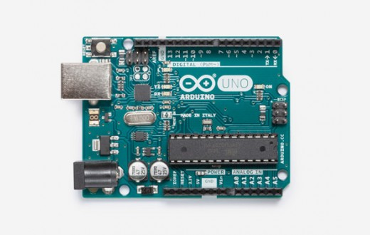
COMPONENTS
MICROCONTROLLER
Arduino Uno R3

Slide 5
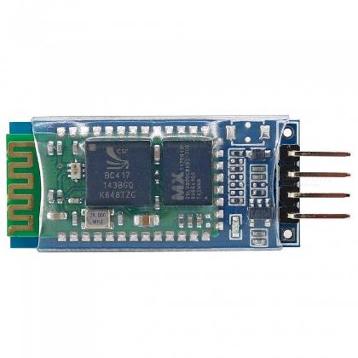
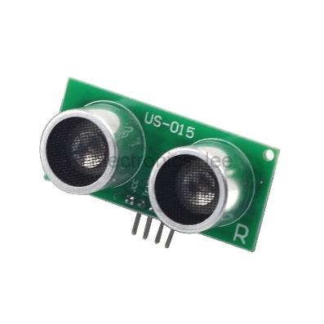
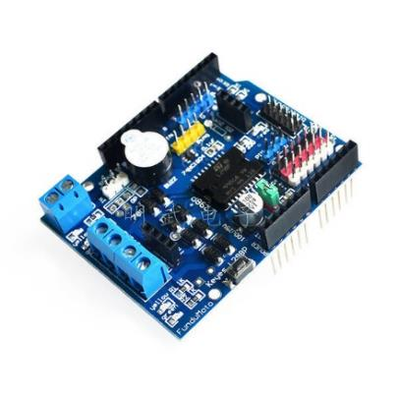
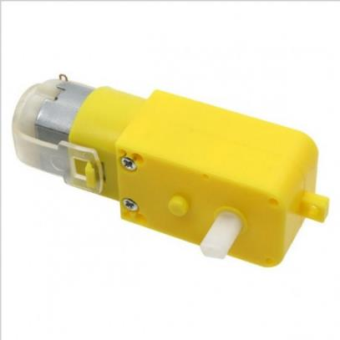
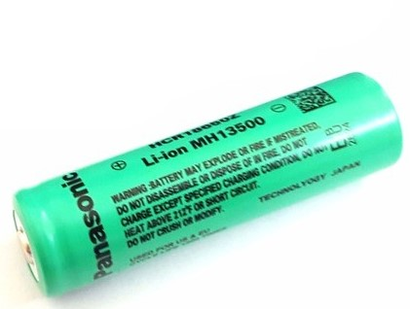
COMPONENTS
Module Bluetooth HC06
Ultrasonic sensor US-015
L298N shield
DC motor
Battery

Slide 6
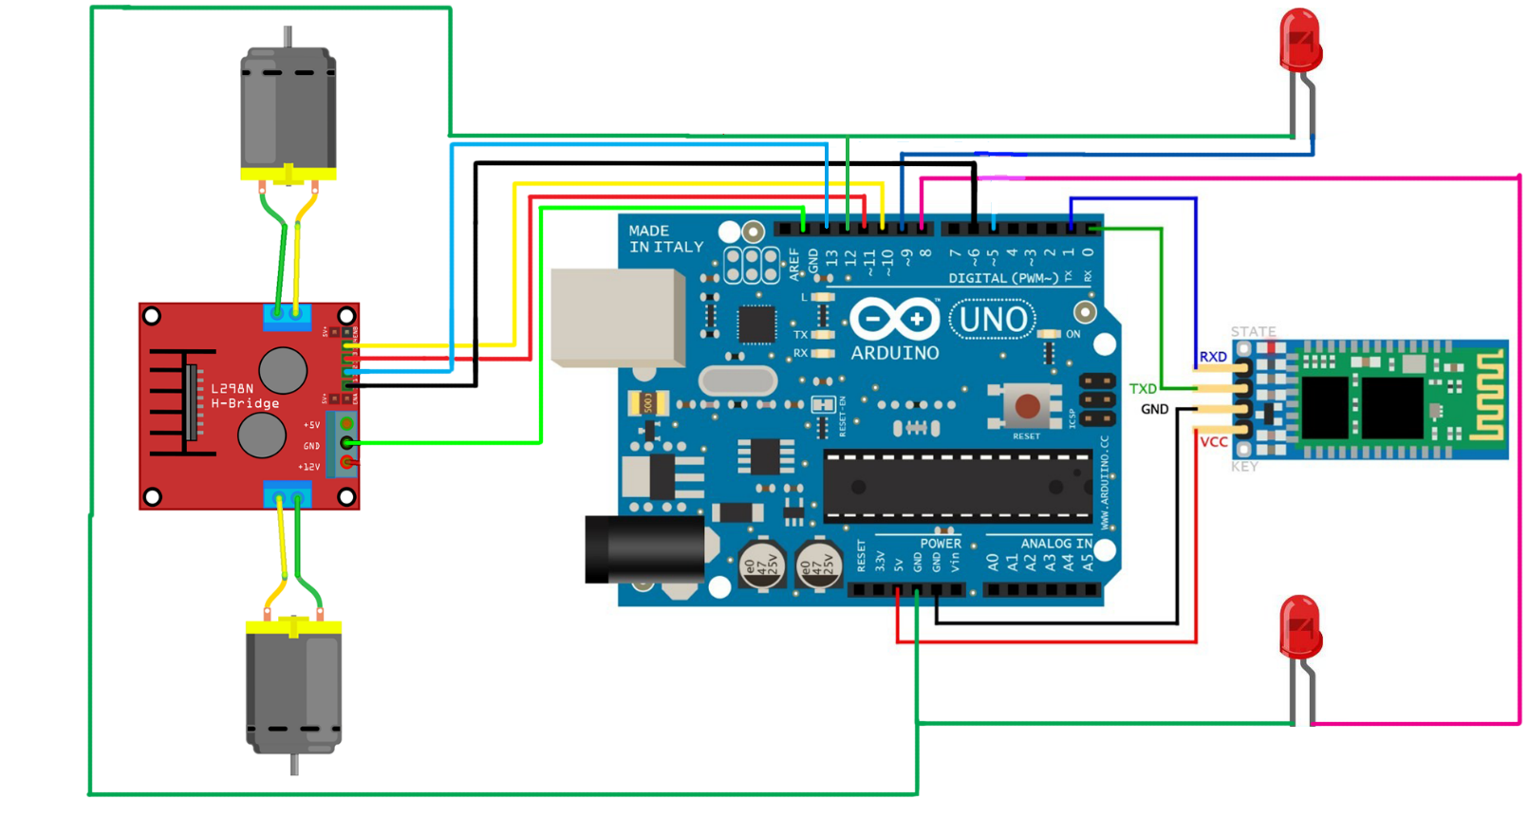
²
METHOD

Slide 7
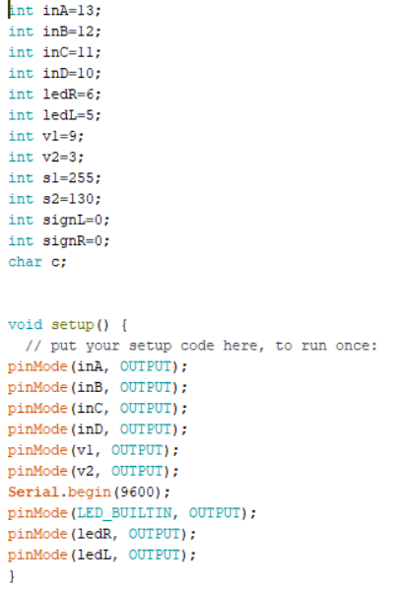
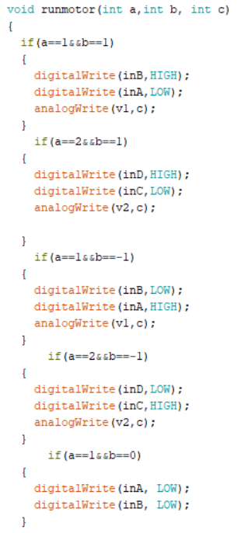
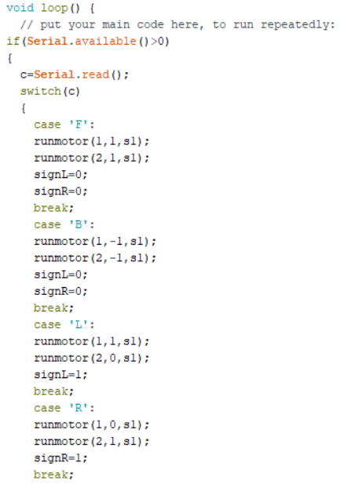
Controller code

Slide 8
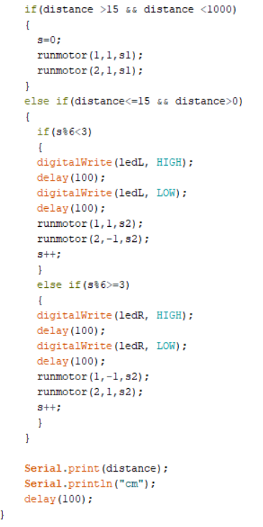
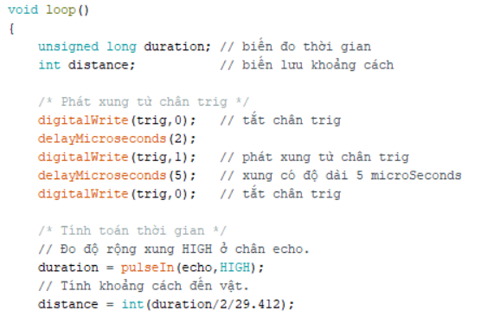

Slide 9
Result

Slide 10
THANK YOU
For your
listening!

